Slide 1
The Search for “living beta"
Utilizing network science to unlock the secrets of the stock market
2nd Workshop on Statistical Physics of Financial and Economic Networks
Matthew Oldham
June 19,, 2017

Slide 2
Agenda
Research Motivation
Background
Approach
Findings

Slide 3
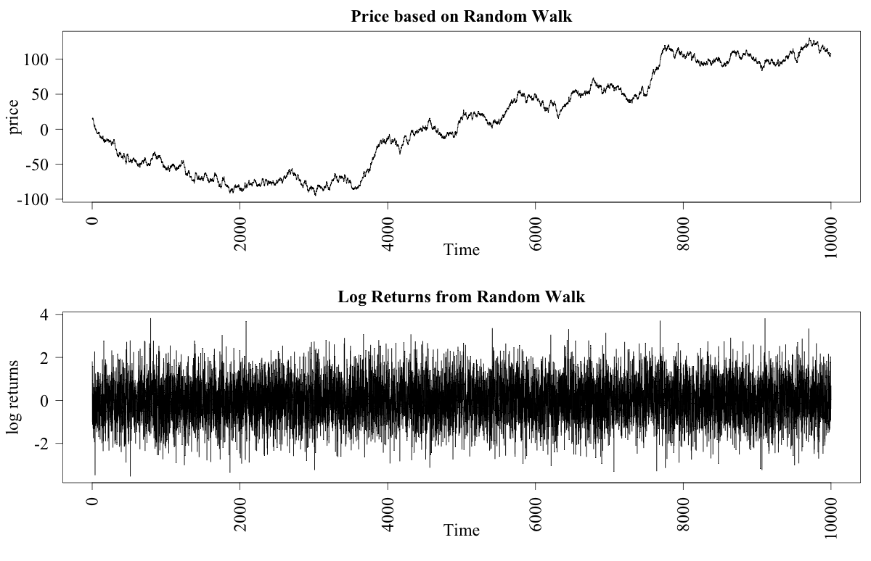
Returns are meant to look like this

Slide 4
The Impact of the Global financial crisis
54% of the of the S&P 500 lost (approx. $7,560 billion)
$11.9 trillion wiped from the global economy as a result of the GFC
Can network science contribute anything to the understanding of how and why the crash occurred?

Slide 5
The after stocks continue
Not just the decline in 2008
Continued volatility, outside the range of what would be expected

Slide 6
Could there be an alternate approach?
Stock markets as a complex adaptive system (CAS)
Agent-based models (ABMs) have gotten closer to the actual return distributions
These models have included networks between investors
Other works have looked at investor networks but not really company/investor bipartite networks nor the dynamics

Slide 7
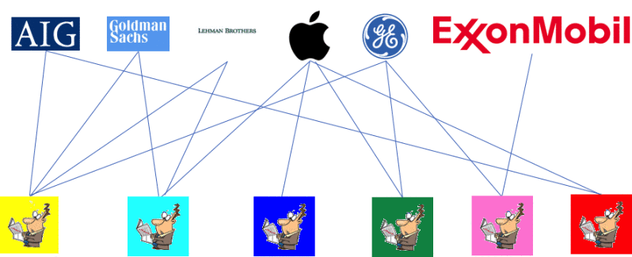
Bipartite approach

Slide 8
How to define links
Binary but links can also be weighted
Number of shares held
Or % of total shares on offer
May provide additional insight

Slide 9
How to form the network
WHARTON RESEARCH DATA SERVICES WEBSITE
THOMSON REUTERS: INSTITUTIONAL 13F HOLDINGS
INSTITUTIONAL HOLDER – USE A US POSTAGE ADDRESS AND OVER 100 MILLION IN ASSETS UNDER MANAGEMENT
HAVE APPROX 4 MILLION RECORDS FOR 16 QUARTERS
477 COMPANIES – complete set across the sample period
3,000+ Distinct Investors.
By 2010 it was estimated that 67% of all domestic stocks were controlled by institutions.
Must report for four months once they hit the threshold

Slide 10
Variation in the number of reporting investors
Study is on US Institutional investors so if they lost that title, little I could do
An important dynamic regardless in terms of investors and how they came and left the market
Can still form weighted network in terms of number of shares owned (not done here)

Slide 11
THE S&P 500 Quarterly Bipartite Network 2007 -2010

Slide 12
Bipartite approach
Projection of bipartite onto one class wrong – Opsahl (2013)
Creation of links different. No longer independent
Projected network will have larger and more fully connected cliques

Slide 13
An alternate approach
Developed new measure which we will see, and the ones that caused confusion last week
Instead of triangles now 4 paths.
Global -
Weighted -

Slide 14
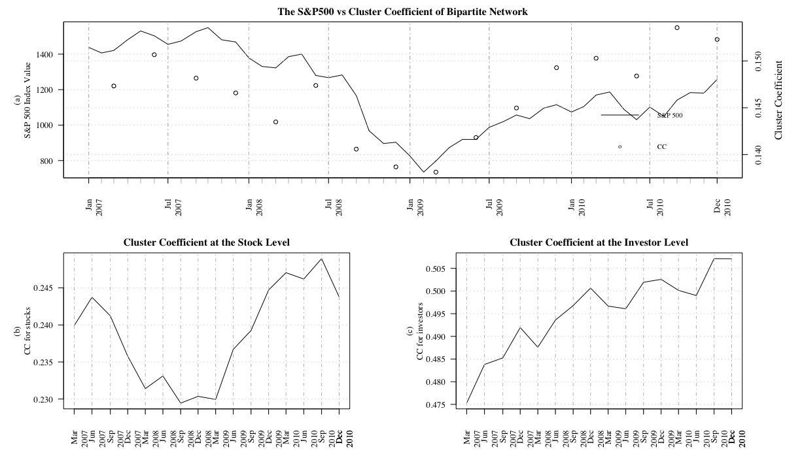
Finding one
Regardless of the approach taken a clear relationship exists between the market and the network
Note, even if the GFC was a fluke still see it in the mid 2010 correction

Slide 15
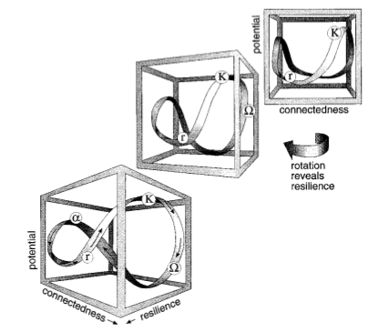
What might be driving the dynamic
The Adaptive Cycle (Holling (2001)
Stage | Resilience | Potential | Connectedness
Exploration (r) | High | Low | Low
Conservation (K) | Low | High | High
Release (Ω) | Low (but increasing) | Low | High (but decreasing)
Reorganization (α) | High | High | Low

Slide 16
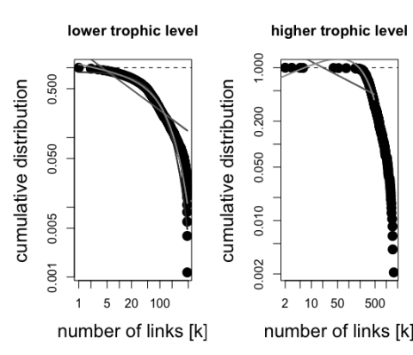
Investor holdings and stock holders
Cum. Investor Degree Dist.
Cum. Stock Degree Dist.
Other works suggest that there should be a power-law like distributions
A few outliers in terms of the investors in a stock (rhs) upset this
Investors in stocks skewed but not power-law like

Slide 17
A closer look
Investors tended to hold more stocks after the recovery
The range increases monotonically, line-in with the prior cluster coefficient
The average shareholder base also increases but the range does not show the same dynamic

Slide 18
Can also create separate networks

Slide 19
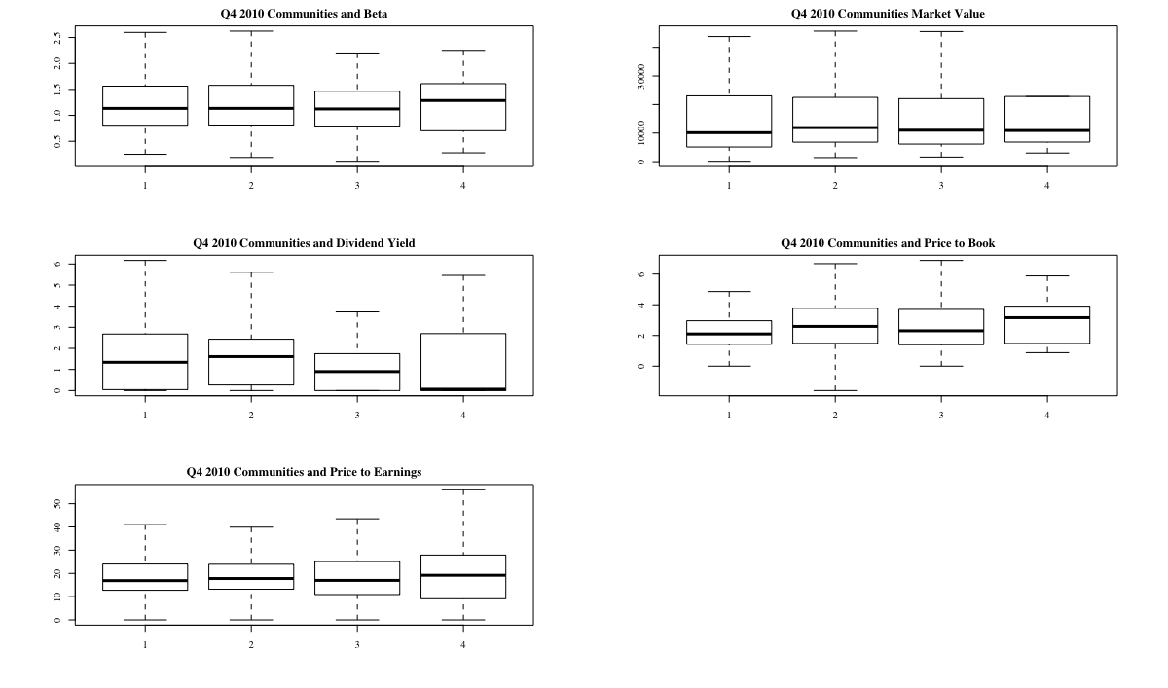
Community detection (or lack of)
Communities should emerge in line with investing habits
With the projected network the increased density limits the effectiveness of this process
Community size was skewed

Slide 20
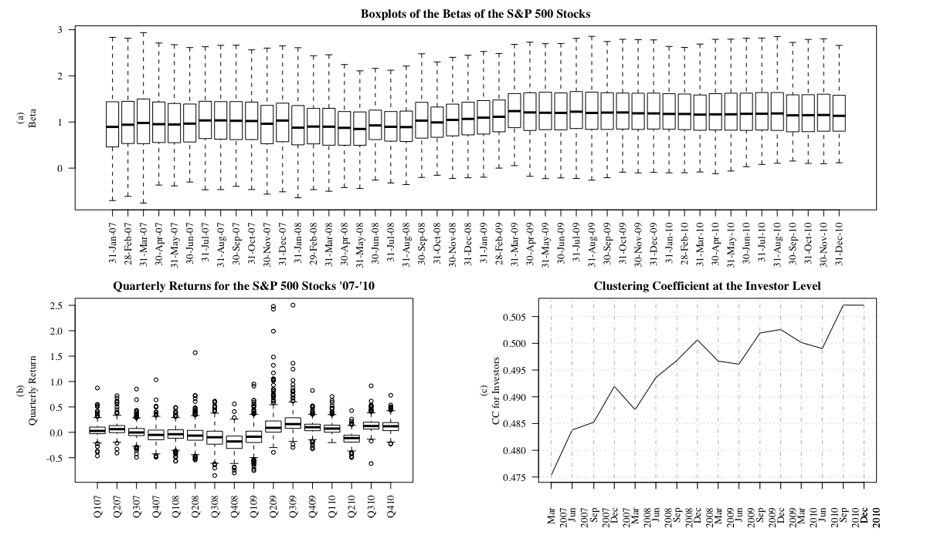
The living beta piece
An attempt to link the network dynamics to price
CAPM Beta is an “effective” measure of how a stock moves with the market
The variation in Beta declines
So to do returns
Why?
Managers are tending to but the market. Lower conviction

Slide 21
Is there a relationship between the two?
Returns varied more than degree
Not surprising given the environment
Returns and change in degree appear positively related – logical
Strength of the relationship is not clear though

Slide 22
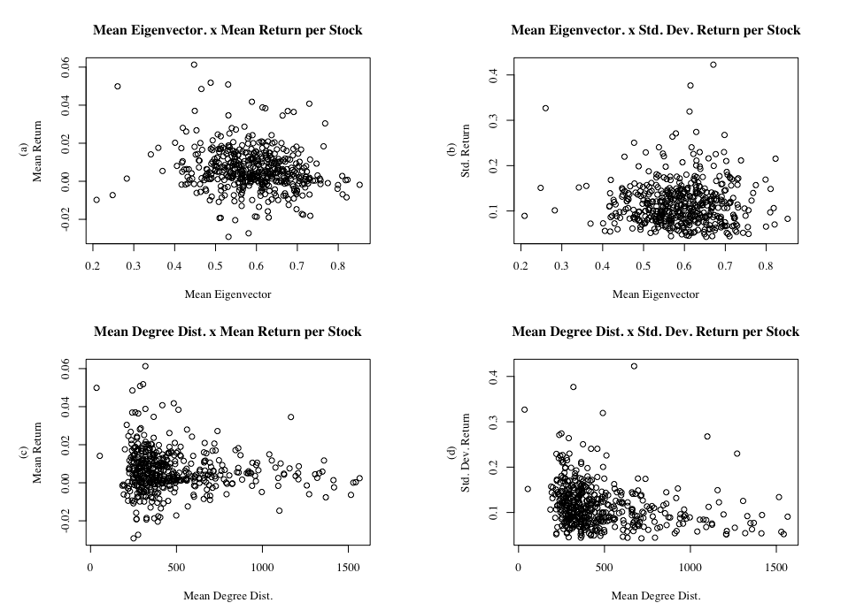
Maybe a result worth mentioning
The standard deviation of returns roughly associated with the degree distribution
Logical to a degree – more holders harder for any one manager to affect the price
All may run for the exit at once though

Slide 23
Conclusions
An analysis of the network provided some useful insights
Built a promising framework
Much work to do though
Which way to go? Projection or bipartite network
Who held the shares outside of the institutional network

Slide 24
Questions

